Slide 1
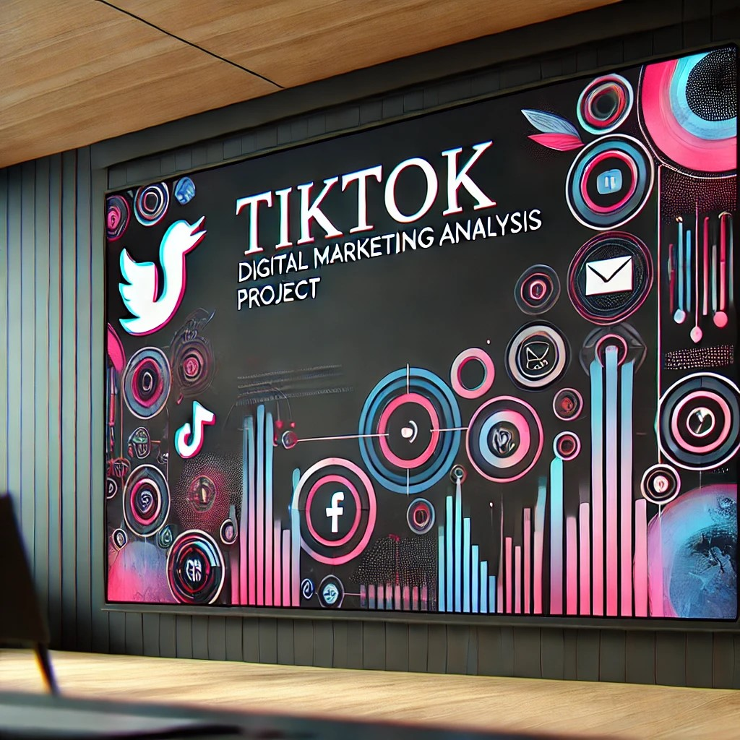
TikTok Digital Marketing Analysis!!

Slide 2
Optimizing Content Strategies Through Data-Driven Insights
Focus Areas: Audience Segmentation | Content Performance | Hashtag Analysis | Marketing Optimization
Deliverables: Interactive Dashboard | Predictive Insights | Actionable Recommendations
TOOLS USED: SQL, Power BI,Advanced Excel

Slide 3
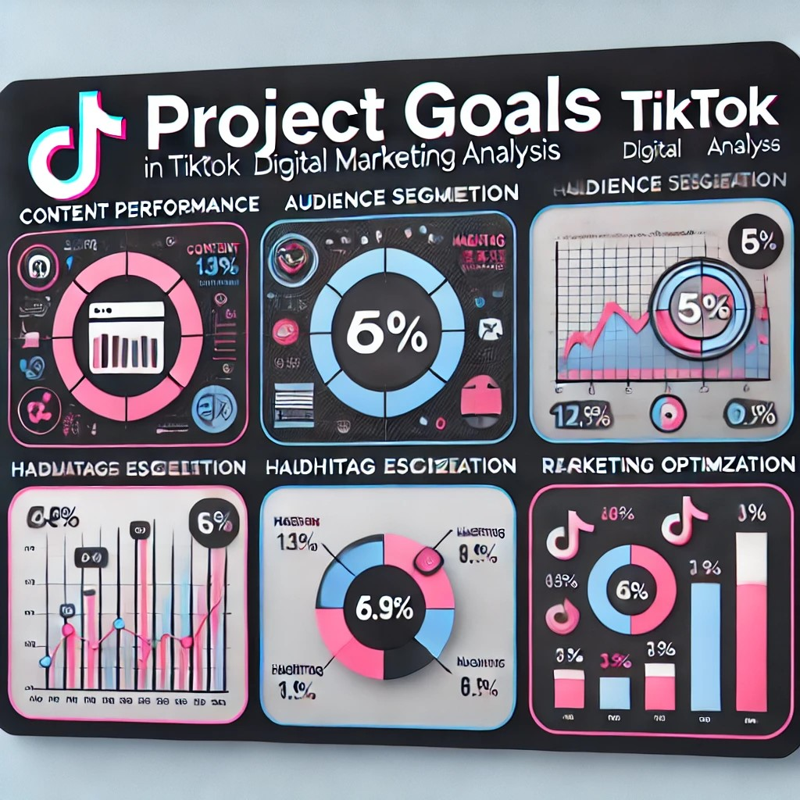
PROJECT GOALS
Content Performance: Identify high-engagement content types and formats.
Audience Segmentation: Analyze trends across demographics and regions.
Hashtag Effectiveness: Assess hashtag popularity and engagement trends.
Marketing Optimization: Improve campaign strategies for targeted demographics.
Regional Insights: Compare engagement metrics by location.
Time and Interaction: Correlate engagement with content formats and timing.

Slide 4
METHODOLOGY
Data extraction and cleaning using SQL queries with advanced functions & techniques.
Insights derived from data analysis.
Visualization through an interactive Power BI dashboard.
Predictive analysis to forecast user engagement trends

Slide 5

Key Insights Content Performance
Videos with trending hashtags saw 45% higher likes.
Educational videos received 65% more comments.
Interactive content held user attention for 12 seconds longer.
Audience Segmentation:
Engagement among 19-24-year-olds was 20% higher.
Male users preferred tech content by 30%, while females favored lifestyle content by 40%.

Slide 6
Hashtag Effectiveness:
Hashtags like #LearnWithTikTok drove 50% more engagement among urban users.
Region-specific hashtags increased views by 35%.
Marketing Optimization:
Scholarship-related videos captured 60% of interactions from users aged 18-21.
Shift focus from underperforming image posts (25% less engagement) to videos.

Slide 7
Regional and Timing Insights Regional Engagement:
Southern region contributed 55% of total engagement.
Western region had only 15%, indicating a need for targeted campaigns.
Timing Insights:
Posts between 6PM and 9PM achieved 35% higher engagement.
Short videos (<30 seconds) held user attention 20% longer.

Slide 8
Advanced Analytics
SQL queries incorporated advanced window and aggregate functions for precise analysis.
Predictive models estimated a 15% increase in engagement with tailored strategies.
11.01.XX

Slide 9
Deliverables
Interactive Dashboard: Displays metrics such as likes, shares, comments, and trends.
Actionable Recommendations: Data-driven strategies for optimizing TikTok campaigns.
Predictive Insights: Estimated future engagement levels to guide marketing decisions.

Slide 10
CONCLUSION
Comprehensive analysis to enhance TikTok marketing ROI.
Tailored content strategies for specific audience segments.
Valuable contribution to portfolio demonstrating advanced data analytics and visualization skills.

